Slide 1
INTRO TO AI/ML

Slide 2
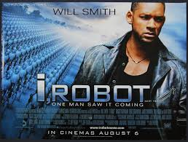


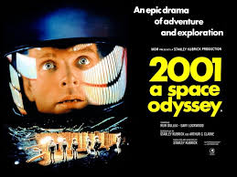
Welcome to Science Fiction
What do you think is artificial intelligence or machine learning?

Slide 3

What is in my backpack?
You get 20
yes or no questions

Slide 4
Overview of AI/ML Training
Intro to AI/ML - what it is and isn’t
Solving AI/ML through Alteryx
Solving your customer’s problems through AI/ML
Accelerating AI/ML through DataRobot

Slide 5

Contents
What is data science?
What is AI/ML?
What is an algorithm?
When should you use AI/ML?
How to build AI/ML models?

Slide 6
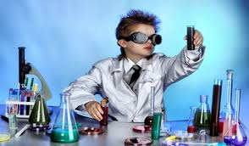
1. What is data science?

Slide 7



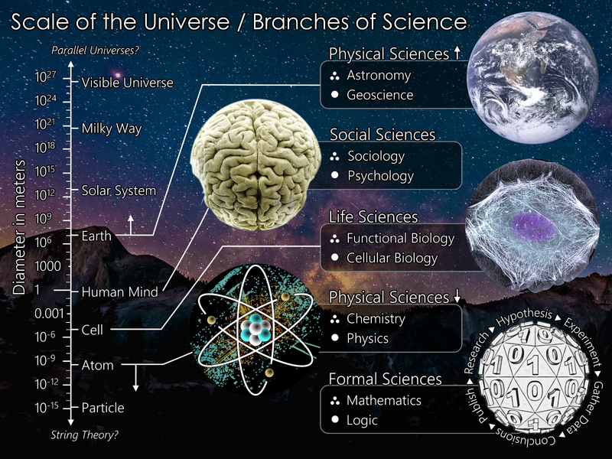
What is science?
Science is a systematic way to tell the story of what you observe about the universe
Fact. Not Opinion or Preferences
Account for all observations
Can predict
Doesn’t contradict known fact

Slide 8
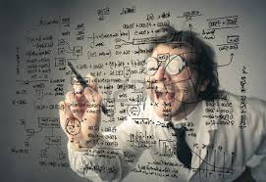
What is the scientific method?
1. Observation
2. Question
4. Prediction
6. Iterate
3. Hypothesis
5. Test
Data science is rooted in the scientific method

Slide 9
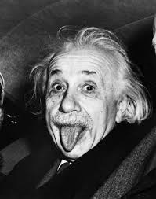

What is a data scientist?
One who uses the scientific method to extract meaning (tell a story) from large quantities of data

Slide 10
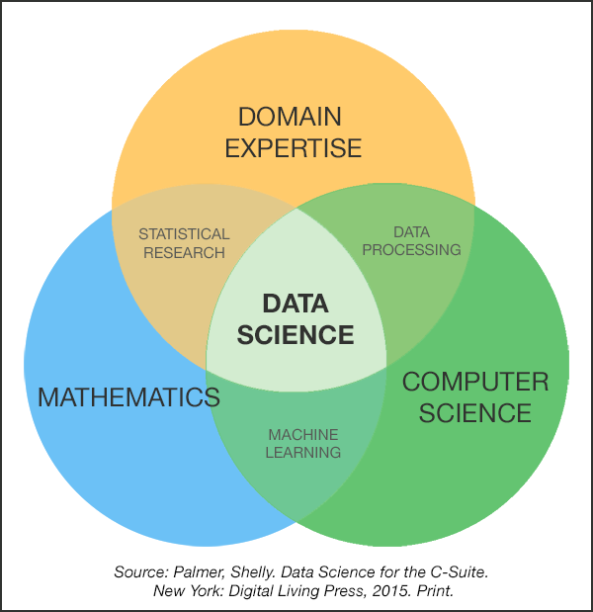
What is Data Science?
Data science (or data-driven science), is an interdisciplinary field of methods, processes, algorithms and systems to extract knowledge or insights from data in various forms, either structured or unstructured.
Business Intelligence
Statistics
Data(base) Management
Visualization
Machine Learning
Data Mining
Artificial Intelligence
Big Data

Slide 11
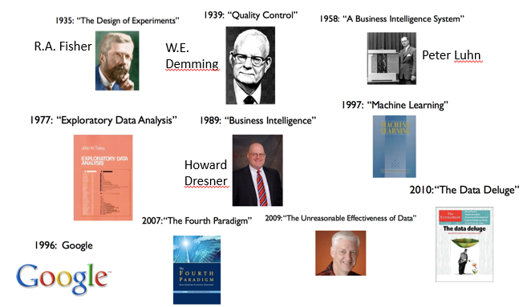
History of Data Science

Slide 12
Analytics Protocol
Problem Formulation
Data Management
Development
Deployment
Management
Understand the business problem
Check if there is related work that was completed or in the process of being developed in GDIA
Discuss alternate analytic methods
Ensure that solution can be integrated into business process
Structure the business problem for analytic solution
Obtain Information/data relative to the analytic model to be made Collect the data Understand the data and make sure data definitions match the business operational definitions Prepare the data
Evaluate, select, and implement analytic methods Validate – out of sample/time validation Assess uncertainty
Present predictions/ forecasts Consider “Spread” (i.e. consider how this analytic solution can be utilized in other areas) Be clear on the assumptions and limitations on the model so that it is used for the correct purpose
Learning that will improve prediction/ forecast procedures Monitoring the prediction/forecasting process
Keep good records
These 5 steps are the GDIA Analytics Protocol

Slide 13

How do we build solutions?
1. Problem Formulation
3. Development
5. Management
2. Data Management
4. Deployment
We are looking to solve problems with business value

Slide 14
How do we build solutions?
1. Problem Formulation
3. Development
5. Management
2. Data Management
4. Deployment
The business partner should be involved in every aspect of the process
Business Partner

Slide 15


How to Engage with Business Partners
Silos
Partnership
You
Them
What do they see?
What are they asking?
Work together to clarify the problems
Work together to formulate clear questions

Slide 16
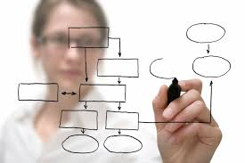
Importance of Engagement
Business Focus
Partnership
Data Science Focus
No clear question
Vague problems
Impossible to measure
Clear question
Clear problems
Clear analytics
Answers wrong question
Narrow problems
Guesses the business
From beginning to end engage in partnership with your business partners

Slide 17
1. Problem Formulation
1. Problem Formulation
3. Development
5. Management
2. Data Management
4. Deployment
Business Partner

Slide 18
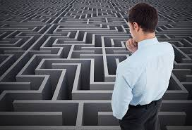
How to frame a problem
Problem…
an inquiry starting from given conditions to investigate or demonstrate a fact, result, or law
Understand the business need
Understand the data
Identify your assumptions
Write a clear one sentence describing the problem
Validate with business partners
“It is the mark of a truly intelligent person to be moved by statistics.”
-George Bernard Shaw

Slide 19
2. Data Management
1. Problem Formulation
3. Development
5. Management
2. Data Management
4. Deployment
Business Partner

Slide 20


Data Needs
Questions to ask yourself
What question are you answering?
What data do you need?
What data can you acquire?
What happens if you don’t
Often pull way too many lines
Need more focused question
Be aware of data security issues
Just because we have the data does not mean you should pull it!

Slide 21
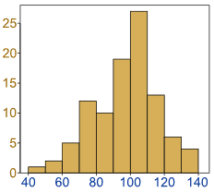

Data Exploration
Who?
What?
When?
Where?
How many?
Explore the data to build your hypothesis

Slide 22
3. Development
1. Problem Formulation
3. Development
5. Management
2. Data Management
4. Deployment
Business Partner

Slide 23
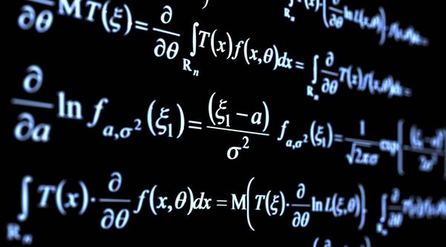
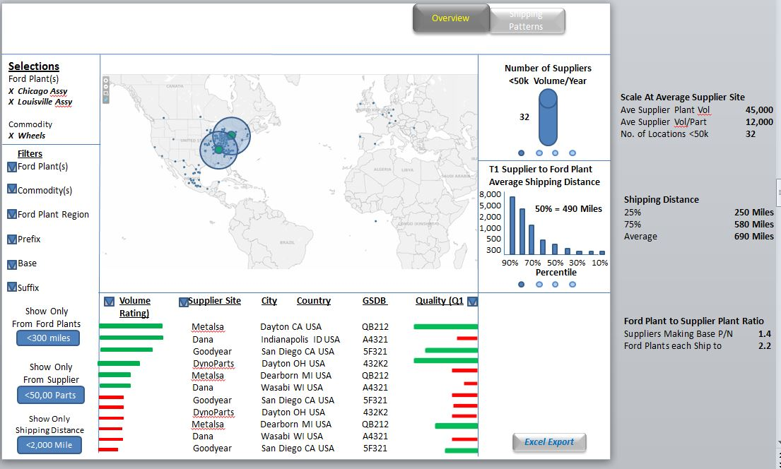
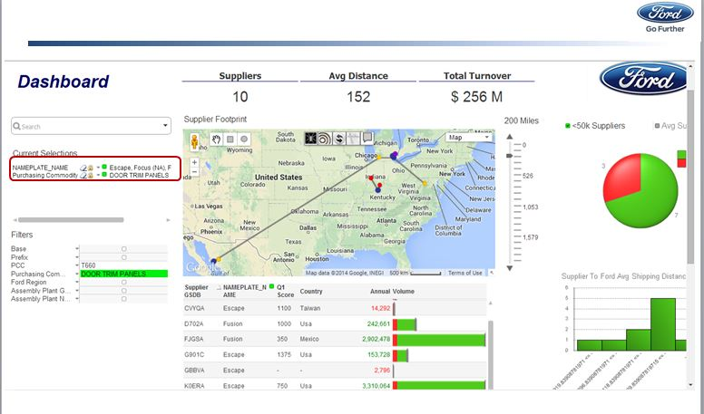
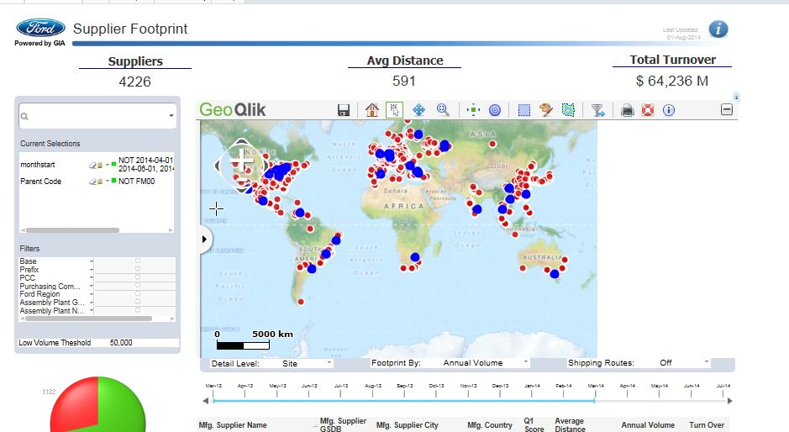
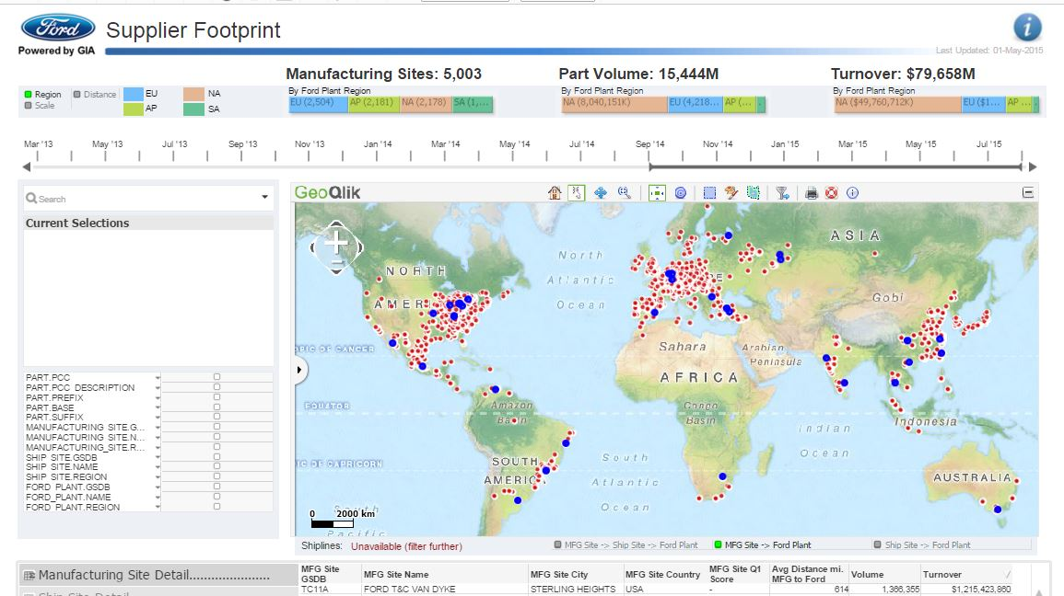

Solution Development
1.
2.
3.
2.
Problem Formulation
- One Clear Sentence
Wireframe
- PowerPoint
Proof of Concept
- Laptop
4.
5.
6.
Pilot
- Pilot Server
Production
- Prod Server
Training and Rollout
- Users

Slide 24
4. Deployment
1. Problem Formulation
3. Development
5. Management
2. Data Management
4. Deployment
Business Partner

Slide 25






Deployment Process
Pilot
Via SharePoint
Design Review
Development
Deployed on Pilot
Business Validation
Prod
Via SharePoint
Detailed Review
Deployed on Prod

Slide 26
5. Management
1. Problem Formulation
3. Development
5. Management
2. Data Management
4. Deployment
Business Partner

Slide 27
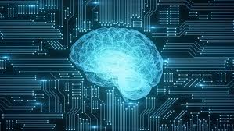
2. What is AI/ML?

Slide 28


What is Artificial Intelligence?
“the theory and development of computer systems able to perform tasks that normally require human intelligence, such as visual perception, speech recognition, decision-making, and translation between languages.”
-dictionary.com
The term “artificial intelligence” came to inception in 1956 by a group of researchers including Allen Newell and Herbert A. Simon
Notes:
The tool dtaarobot is not a good tool for anything but decision making

Slide 29

What is Machine Learning?
“the scientific study of algorithms and statistical models that computer systems use to perform a specific task without using explicit instructions, relying on patterns and inference instead. “ - wikipedia
Relies on math models
Built from data
Subset of AI
“Machine learning is the study of computer algorithms that allow computer programs to automatically improve through experience.”
- Tom M. Mitchell, computer scientist and machine learning pioneer

Slide 30
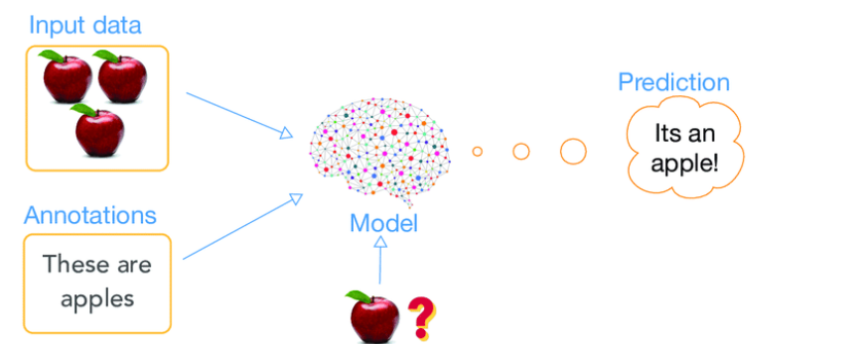
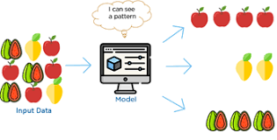
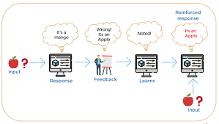
What are the types of Machine Learning?
Supervised Learning
Algorithm with a target variable that is predicted from a given set of predictors – generates function that maps inputs to desired outputs
2. Unsupervised Learning
Algorithm with no target variable to predict – clusters population into different groups
3. Reinforcement Learning
Algorithm where machine is trained to make specific decisions and learns through trial and error.
Notes:
Structrued data

Slide 31
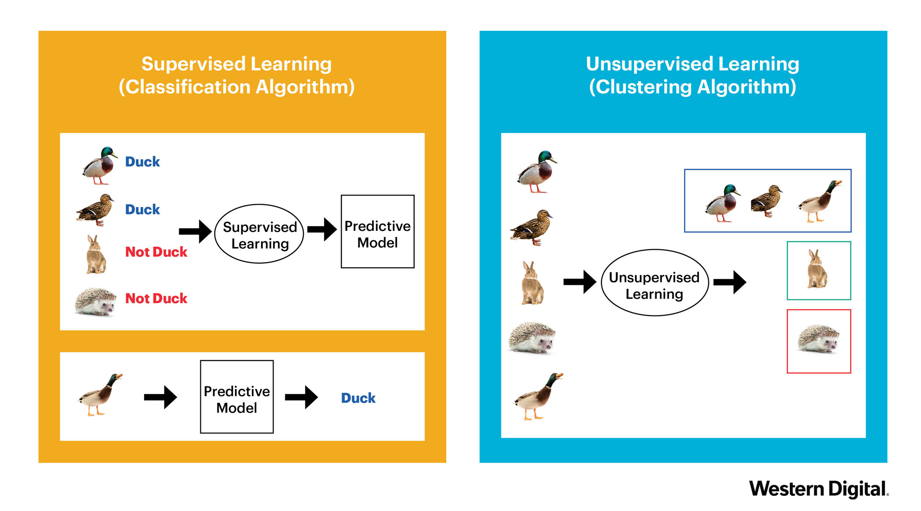
Supervised vs. unsupervised?

Slide 32
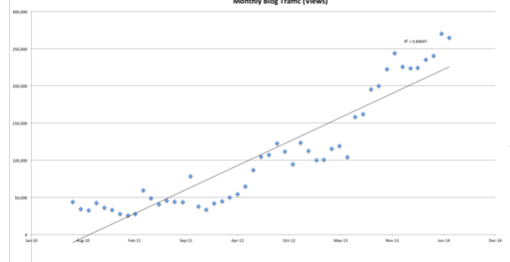
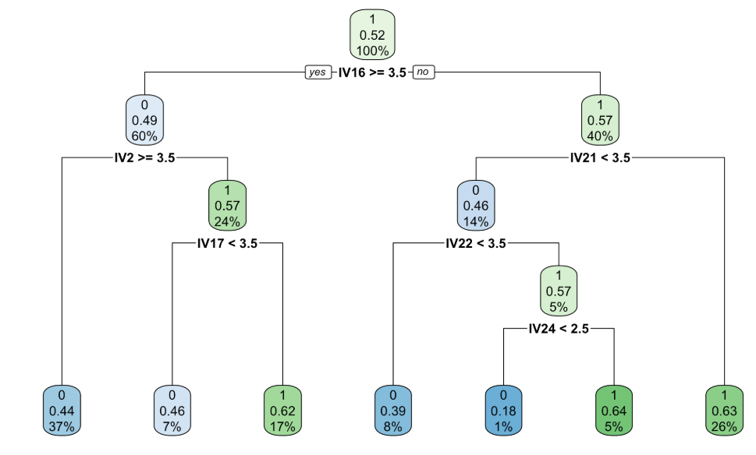
What are some major types of Supervised Learning?
Regression Analysis
Classification Analysis
Fits the data
Linear regression
Logistic regression
Polynomial regression
Lasso/elastic regression
Separates the data
Decision Trees
Random Forest
K Nearest Neighbors
Support Vector Machine
Notes:
Two main categories

Slide 33
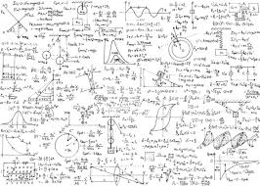
3. What is an algorithm?

Slide 34

Defining an algorithm
“a process or set of rules to be followed in calculations or other problem-solving operations, especially by a computer.” - dictionary.com
“In mathematics and computer science, an algorithm is a set of instructions, typically to solve a class of problems or perform a computation. Algorithms are unambiguous specifications for performing calculation, data processing, automated reasoning, and other tasks.” - Wikipedia
Algorithms are instructions on how to solve a problem

Slide 35
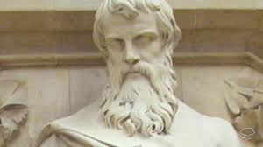
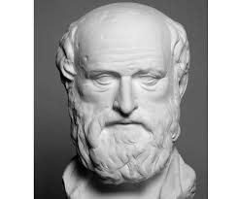
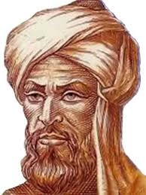
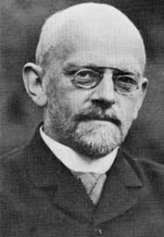
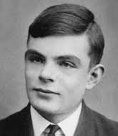
History of algorithms
Euclid (c. 350-250 BC)
Greek mathematician who used an Algorithm to find Greatest Common Divisor – founder of geometry
Eratosthenes (276-196 BC)
Greek mathematician who used an Algorithm to find prime numbers
Muhammad ibn Mūsā al-Khwārizmī ( c. 780 – c. 850)
Founder of algebra - algorithmi is Latinized version of his name
"Good, he did not have enough imagination to become a mathematician“
– Hilbert when he learned a student dropped out to study poetry
David Hilbert (1862-1943)
Partial formulation of the modern concept of algorithm
Alan Turing (1912-1954)
formalization of the concepts of algorithm

Slide 36

Example of an algorithm
Suppose you had a set with the following numbers 3,1,5,19 and you wanted to sort from biggest to smallest
What steps would you do?

Slide 37
Example of an algorithm
Step 1: Assume first number is largest. 3,1,5,19
Step 2: Go to second number – is it bigger than the first? If yes switch positions. If no leave as is. 3,1,5,19
Step 3: Go to third number - is it bigger than the second? If yes switch positions and go to step 4. If no go to step 5. 3,5,1,19
Step 4: Go to new second number - is it bigger than the first? If yes switch positions. If no leave as is. 5,3,1,19
Step 5: Go to fourth number is - it bigger than the third? If yes switch positions, if no leave as is and end. . 5,3,19,1
Step 6: Go to new third number – is it bigger than the second? If yes switch positions, if not leave as is and end. . 5,19,3,1
Step 7: Go to new second number - is it bigger than the first? If yes switch positions. If no leave as is. Then end. 19,5,3,1

Slide 38

Why are algorithms important for AI/ML?
Machine Learning uses algorithms for models
Statistical sets of instructions on how to predict
Some algorithms can then improve over time
Input: Data
AI/ML Algorithm
Output: Predictions

Slide 39
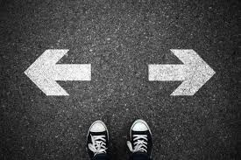
4. When should you use AI/ML?

Slide 40
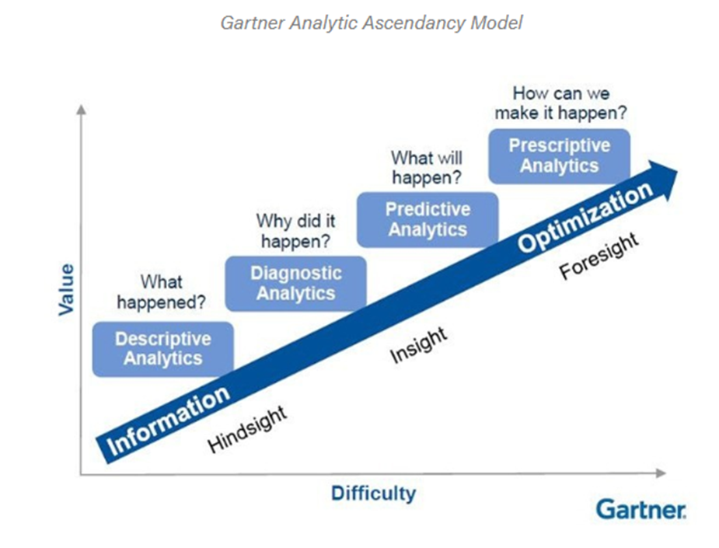
Determine how to answer the problem

Slide 41

When should you not use AI/ML?
You don’t have enough data – risk of bias
You have “noisy” or messy data - irrelevant information can cause the data to memorize noise
You have incomplete data – need to have a plan to impute or leave out
You are in a hurry
You have a simple problem to solve

Slide 42

When should you use AI/ML?
You cannot code the rules
You have a large-scale problem
You have a lot of clean, labelled data
You want to find a pattern to predict outcomes or relationships

Slide 43

5. How do I create models?

Slide 44
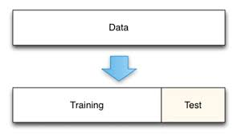
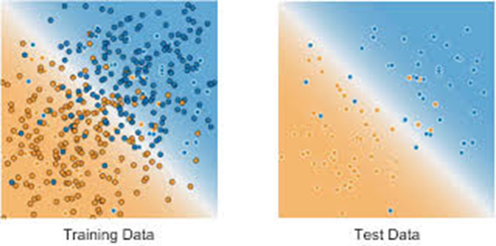
Step 1: Select Training vs. Test Data
Separate data into 2 chunks
Training data used to fit the model
Test data used to validate the model
70%
30%
This helps eliminate bias and overfitting

Slide 45
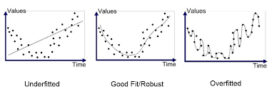
What is Overfitting?
“An analysis that corresponds too closely or exactly to a particular set of data, and may therefore fail to fit additional data or predict future observations reliably".
Matching the exact data points – not the characteristics of the data

Slide 46
Step 2: Build the model
Create training data
Input training data
Produce Model
Choose algorithm

Slide 47
Step 3: Validate and tune the model
Create training data
Input training data
Produce Model
Choose algorithm
Input test data
Validate Model
Tune Model
Deploy Model

Slide 48
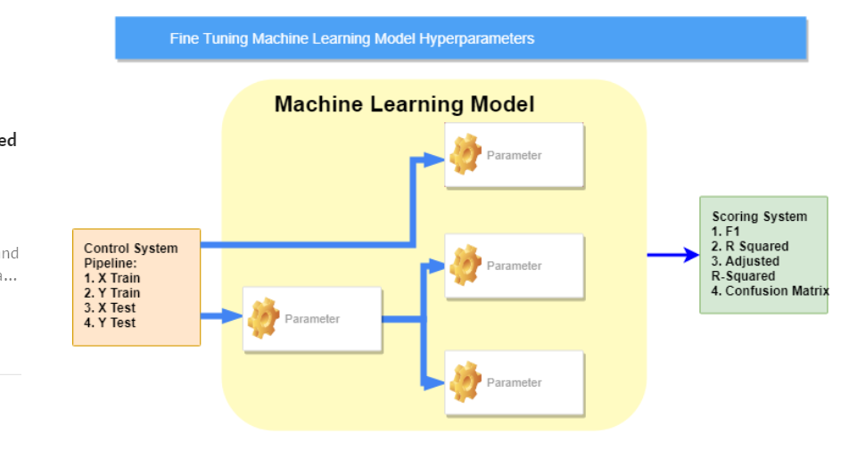
What is tuning?
Adjusting certain parameters of the algorithm to gain the greatest accuracy

Slide 49
Review
What is data science?
What is AI/ML?
What is an algorithm?
When should you use AI/ML?
How to build AI/ML models?

Slide 50

Conducting an Orchestra

